Slide 1
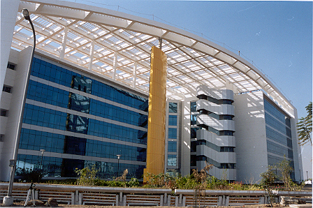

CareMore
Induction
Aug 12, 2015

Slide 2
Agenda
Background
CareMore Footprint – Applications
Cognizant’s Accomplishment
Organization Chart
Resources – Onshore v/s Offshore
© 2014, Cognizant Technology Solutions. Confidential

Slide 3
Background
  CareMore is Medicare Advantage plan HMO with a clinical model that promotes wellness has expertise in multiple chronic disease management and uses a reimbursement model that includes pay for performance incentives.
  CareMore was acquired by Anthem in August 2011 with a vision of bringing the CareMore model to the Anthem’s 70 million members in states
  Anthem has launched CareMore products as Blue-Branded products in NY and VA markets for the 2013 Annual Enrollment Period
  Anthem & CareMore have taken the initial steps to integrate the two payers and setting up connectivity while reducing member and provider abrasion during the early phases of CareMore product launch under the Anthem brand.
© 2014, Cognizant Technology Solutions. Confidential

Slide 4
Claims
/
Pricing
Service Business Interface
Encounter Intake
Principal Dental
ClearingHouse
Operations
Safeguard
Office Ally
VSP
Block Vision
Image Net
Enrollment
UniLab
Labcorp
Assign
SJMG
Sales Force
Nearest
WLP Clarity
.
com
\
Provider
Provider Ranking
(
ID Card Printing
OnlineStore
PCP
Tool
Vendor
Caremore
)
Customer
Facets Letter
service
Server
Personnel
Payment
&
Recoveiries
Caremore
IVR
/
Customer
837
Enrollment DB
.
com
Service
P
Member
r
M
Outreach Portal
o
v
e
i
EDI
\
HIPAA
d
m
e
b
r
e
Gateway
E
r
l
s
i
g
h
i
i
b
p
i
l
i
&
t
EDI Claims
y
App
XC Load
Facets
Batch
Facets
Key word
(
es
)
XC DB
To
/
From
INFOCROSSING
Anthem
-
File
(
s
)
CODS
CMS
Enterprise
NetworX Pricer
Adjudication
NetworX Pricer
Job
RAPS
/
EDPS
Finance
s
CODS
_
TRN
RAPS File
t
e
CODS DB
Data
WLP
c
Integration
a
Peoplesoft
F
Facets
CMS
Bank of America
Positive Pay
CMSpecCap
Premium
Datawarehouse
Extract
Replication
Emdeon
/
FCS
Check
\
EOB
\
ERA
\
1099
Broker System
Facets
Care Management
SVDB
Supp

Slide 5
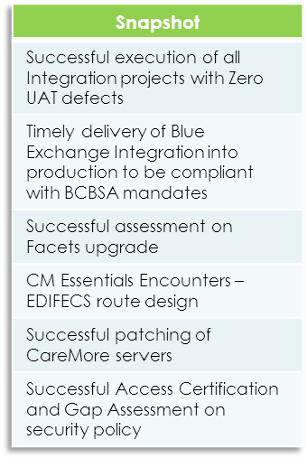
Accomplishments by Cognizant
Following projects are based on the recommendations that Cognizant made during the discovery engagement and successfully implemented them
SL# | Project | Component Detail | Stakeholder
1 | Blue Exchange Integration | Business Service Layer to service Blue Exchange requests (270, 276 and 278) | Cognizant
2 | ITS Integration | CareMore Claims feed to Anthem for generation of DFs | Cognizant
3 | NPI | Provider information feed to Provider Finder | Cognizant
4 | ESI Integration | Claims feed to & from Pharmacy Vendor ESI to sync up Accumulators | Cognizant
5 | STAR Broker Integration | Commissions feed from CareMore Facets to Star Broker | Cognizant
6 | Member Portal Integration | Business Service Layer to service requests from Anthem Consumer Portal | Cognizant
7 | Provider Portal Integration | Business Service Layer to service requests from Anthem Provider Portal | Cognizant
8 | EDI | CM Essentials Encounters – Key–In from PDF for 2013 forms | Cognizant
9 | ITIS | Patch management and McAfee implementation | Cognizant
10 | ICD10 Assessment | CareMore IT systems and business functions | Cognizant(Consulting)
11 | Security | Security validations | Cognizant(Consulting and Development)
Engagement Highlights
© 2014, Cognizant Technology Solutions. Confidential

Slide 6
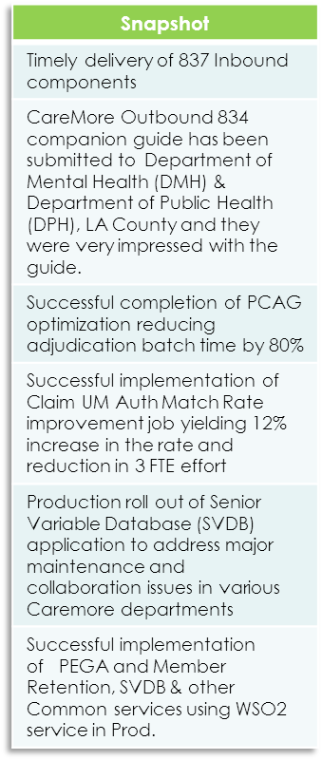
Accomplishments by Cognizant
Following projects are based on the recommendations that Cognizant made during the discovery engagement and successfully implemented them
SL# | Project | Component Detail | Stakeholder
12 | FACETS Upgrade - 4.71 to 5.01 | Version Upgrade Impact Analysis for 4000 Code Objects | Cognizant
13 | Auto PCP Assignment Job | Generic Distance based PCP Assignment Function to be used for Member PCP assignment during member enrollment | Cognizant
14 | Online PCP/Provider search web application | Web Application for performing distance based PCP/Provider search, to be consumed by member services or customer service users | Cognizant
15 | CLMU Batch Split | Batch Split job to separate claims adjudication as high volume and low volume to reduce daily batch window | Cognizant
16 | Claim UM Auth Match Rate improvement | Job to automate Claim UM Auth Match thereby improve claim auth match rate and reduce 3 FTE effort | Cognizant
17 | PCAG Optimization | PCAG rule optimization to improve CLMU batch performance significantly (80% reduction in batch runtime) | Cognizant
18 | Provider load using XPF keyword | Vendor specific XPF keyword generation for new provider load and provider maintenance update for Physicians, Facilities and Groups. | Cognizant
19 | SCRIBE | One-stop solution to Create, Save and Retrieve the letter templates, which reduces the template creation workflow time drastically | Cognizant
20 | Inbound Data Service | A generic windows service used to load the files sent by various vendors into the staging tables using the xml format file and bcp format files specific to the vendors | Cognizant
21 | PEGA - Member Status Feed | Feeds Outreach PEGA system with the new, plan changed and CMS re-instated members information on daily basis | Cognizant
22 | SVDB | Application to address major maintenance and collaboration issues over senior variable data like Plan & Product details and logos, which are critical to the needs of CareMore’s booming business | Cognizant
23 | MMS Keyword generation | MMS keywords are created based on the member information from varied sources to input the member details into FACETS. | Cognizant
Engagement Highlights
© 2014, Cognizant Technology Solutions. Confidential

Slide 7
Following projects are based on the recommendations that Cognizant made during the discovery engagement and successfully implemented them
SL# | Project | Component Detail | Stakeholder
24 | Health Journey feed | CMS requires all existing/continuing Special Needs Plan (SNP) members receive an annual health risk assessment, known internally as Healthy Journey, within 365 days from their last HRA. Workbaskets in Pega created to identify existing members that are within 90 days of reaching the anniversary date of when their last HRA was completed. | Cognizant
25 | Case Administration Feed | Pega is creating the cases based on member status feed data availability. The member becomes inactive/opt out then case is resolved manually by CSR. CSR’s need not perform outreach to members who has already opted out or is inactive in Facets. Pega does not need to create the cases. Our Case Admin feed will feed Pega table with all inactive member records for better case administration. | Cognizant
© 2014, Cognizant Technology Solutions. Confidential

Slide 8





Cognizant Organizational Chart
Swaminathan, Rangarajavel (Associate Director)
Sriram Natarajan (AVP)
Subash Chittanuru (Senior Director)
Venkataraman, Maheshwaran
(Director)
Aravind Radhakrishnan
(Senior Manager)
Pravin Nagarajan
(Manager)
Gopalakrishnan Pitchumani
(Manager)
Ravi
Balasubramanian
(Manager)
Arunvijay Veerabadran
(Manager)
Integration of systems under Blue Exchange, Sales & Marketing, Commission, ITS, ESI, NPI DB, Member and Provider portals, EDI, SVDB, Scribe, Inbound Data Service
I
Enablement of CareMore systems for Medicaid and Medicare (Duals) business
Integration of systems under Blue Exchange, Sales & Marketing, Commission, ITS, ESI, NPI DB, Member and Provider portals, EDI, Duals, SVDB, Scribe, Inbound Data Service
© 2014, Cognizant Technology Solutions. Confidential

Slide 9
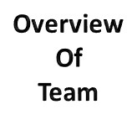
Team Strength – Onshore v/s Offshore
Offshore Team
Onshore Team
61 Associates
  Integration
  FACETS Solutions
  Reports
  ITIS Patch Mgmt
  Security
  Pega
  IT IS LO
42 Associates
  Integration
  FACETS Solutions
  EDI
  Security
  Pega
  Portal
  HCC
  UM
Compliance & Certifications
Mandatory Courses
AUP
COBE & COBEII
HIPAA
NDA
FWA & FWA (General Training)
SOC
Domain Certifications
AHM250
PAHM
© 2014, Cognizant Technology Solutions. Confidential

Slide 10

Project Independent Information
Module Access :
Associate to contact respective PM for the module access
Sign the NDA document
List of Mandatory Courses to be undertaken within 30 days post joining the team :
  AUP
  COBE & COBE II
  HIPAA/HITECH PRIVACY
  FWA & FWA (General Training)
  SOC
  [Anthem PMO will take care of enrolling you for FWA & FWA (General Training) , SOC courses]
List of Mandatory CCP to be undertaken within 60 days post joining the team
  AHM250 CCP
Knowledge Repository :
Knowledge Repository has been created for CareMore projects and maintained in the following share path :
\\ctsintbmntappa\WLP_CareMore\Knowledge Repository
We have documents related to the following areas in it:
  Project related documents
  Technical documents
  HealthCare domain specific documents
  HealthCare Product Documents
  Case Studies
© 2007, Cognizant Technology Solutions. Confidential

Slide 11
Integration Project
SharePoint Link :
  https://ch1hub.cognizant.com/sites/SC51/Shared_Docs/Shared%20Documents/Forms/AllItems.aspx
  POC for SharePoint access: kumar, surendra (ID: 335183)
Share path Link :
  \\ctsintbmntappa\WLP_CareMore
  POC for Share path access : kumar, surendra (ID: 335183)
Coding Standard Document location :
\\ctsintbmntappa\WLP_CareMore\Knowledge Repository\Technical\CareMore_Integration_Coding_Standards.xlsx
(Standards available for Java, .NET, SQL & SSIS)
Code Review Checklist location :
\\ctsintbmntappa\WLP_CareMore\Knowledge Repository\Technical\CareMore_Integration_Code Review Checklist.xlsx
(Standards available for .NET, SQL & SSIS)
© 2007, Cognizant Technology Solutions. Confidential

Slide 12
Integration Project
List of Software to be installed for associates joining Services(Java) project :
List of Software to be installed for associates joining Apps (.Net) project :
Softwares | Version
McAfee Endpoint Encryption for PC | 7
SQL Server Management Studio | 2008 R2
Cisco VPN Client | 5.x
WSO2 ESB Server | 4.7.0
WSO2 DSS Server | 3.0.1
WSO2 Developer Studio Eclipse | JUNO or above
JAVA JDK | 1.6 or above
SOAP UI | 3.5 or above
Google Chrome | latest version
Softwares | Version
McAfee Endpoint Encryption for PC | 7
Cisco VPN Client | 5.x
Visual Studio Professional | 2010
SQL Server Management Studio | 2008 R2
SQL Server Business Intelligence Development Studio | 2008 R2
© 2007, Cognizant Technology Solutions. Confidential

Slide 13
Duals Reports Project
SharePoint Link :
  https://ch1hub.cognizant.com/sites/SC51/Shared_Docs/Shared%20Documents/Forms/AllItems.aspx
  POC for SharePoint access: kumar, surendra (ID: 335183)
Share path Link :
  \\ctsintbmntappa\WLP_CareMore
  POC for Share path access : kumar, surendra (ID: 335183)
  KT Documents location :
  \\ctsintbmntappa\WLP_CareMore\CareMore Projects\01_Active\01_Development\21_EDWReporting\00_References\KT Docs
  Estimation Templates location :
  \\ctsintbmntappa\WLP_CareMore\CareMore Projects\01_Active\01_Development\21_EDWReporting\00_References\Estimation Templates
  Code Review Checklist Location :
  \\ctsintbmntappa\WLP_CareMore\CareMore Projects\01_Active\01_Development\21_EDWReporting\00_References\Code Review Checklist
Coding Standard Document location :
\\ctsintbmntappa\WLP_CareMore\CareMore Projects\01_Active\01_Development\21_EDWReporting\00_References\Coding Standard\CareMore_DualsReports_CodingStandard_V1.4.xlsx
(Standards available for SSRS & SQL)
© 2007, Cognizant Technology Solutions. Confidential

Slide 14
Duals Reports Project
List of Software to be installed for associates joining Duals Reports project :
Softwares | Version
McAfee Endpoint Encryption for PC | 7
RSA SecurID Software Token | 4.1.1
AnyConnect VPN Client | 3.1
Citrix Receiver | 4.1
SQL Server Developer Edition | 2008 R2
SQL Server Business Intelligence Development Studio | 2008 R2
SQLServer Report Builder | 3.0
© 2007, Cognizant Technology Solutions. Confidential

Slide 15
CM FACETS Solutions Project
Sharepoint Link :
  https://ch1hub.cognizant.com/sites/SC51/Shared_Docs/Shared%20Documents/Forms/AllItems.aspx
  POC for Sharepoint access: kumar, surendra (ID: 335183)
Sharepath Link :
  \\ctsintbmceld\WLP_CareMore\
  POC for Sharepath access: kumar, surendra (ID: 335183)
Coding Standard Document location :
  \\ctsintbmceld\WLP_CareMore\CareMore_Duals\01_Active\02_Quality\01_Standards_Checklist
Code Review Checklist location :
  \\ctsintbmceld\WLP_CareMore\CareMore_Duals\01_Active\02_Quality\01_Standards_Checklist
© 2007, Cognizant Technology Solutions. Confidential

Slide 16
CM FACETS Solutions Project
List of Software to be installed for associates joining the FACETS project :
Softwares | Version
McAfee Endpoint Encryption for PC | 7
Cisco AnyConnect Secure Mobility Client | 3.1.01
Visual Studio Professional (On Need Basis) | 2010
SQL Server Management Studio | 2008 R2
SQL Server Business Intelligence Development Studio | 2008 R2
Notepad + | 5.8.6
Visio (On Need Basis) | 2010
RSA SecurID Token | 4.1.1
© 2007, Cognizant Technology Solutions. Confidential

Slide 17
Thank You

